Slide 1
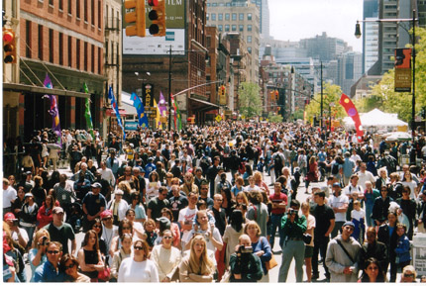
Ecology of Populations

Slide 2
What is Ecology?
“Ecology”
the study of the interactions of organisms w/ its environment.

Slide 3
Population Growth
Populations grow when birth rate exceeds rate of mortality
DEATH

Slide 4
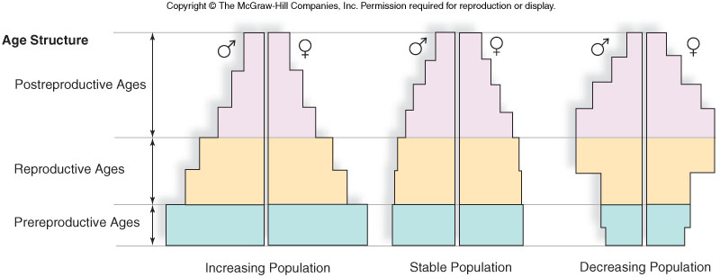
Age Distribution
Age-Structure Diagram shows growth patterns of populations grouped into categories
Horizontal axis = Number of individuals

Slide 5
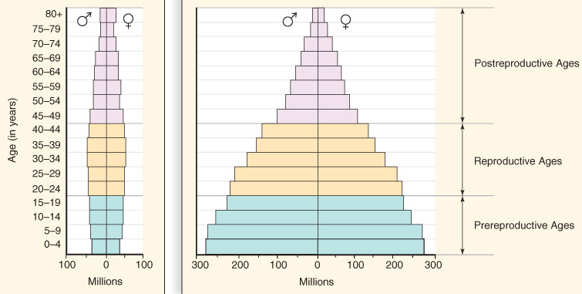
Human Age Distribution
Developed countries
Less-developed countries

Slide 6
Humans are part of the Earth's
ecosystem. Human activities
can either deliberately or
inadvertently
alter the balance
of an ecosystem.

Slide 7
What do you Think???
How do human activities affect the environment?

Slide 8
With more info…
Will you change your perspective or will you feel the same way?

Slide 9
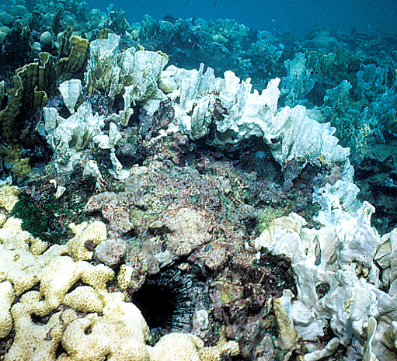
Human impacts on the Environment
Global warming
Use of machinery by humans seems to be increasing CO₂ levels in the air. CO2 prevents heat from escaping, causes slight world wide temperature increases
Rising water temperatures causes coral bleaching

Slide 10
Human impacts on the environment
Deforestation
Caused by demand for wood products,
need for space, farmland, housing,
roads
Deforestation causes
habitat fragmentation
Animals and plants are forced into
confined areas

Slide 11
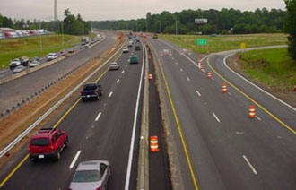
Habitat Fragmentation

Slide 12
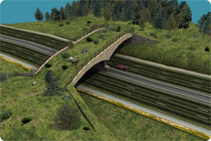
Habitat Fragmentation

Slide 13
Human impacts on the Environment
Ozone depletion
Caused by aerosol chemicals called
chlorofluorocarbons (CFCs)
CFC’s
  Escape into atmosphere, reacts breaking down the ozone (O₃, a protective atmospheric layer)
  UV rays penetrate the atmosphere and cause harm to many organisms

Slide 14
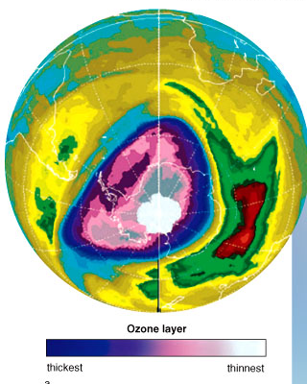
“HOLE” in the ozone (O3)

Slide 15
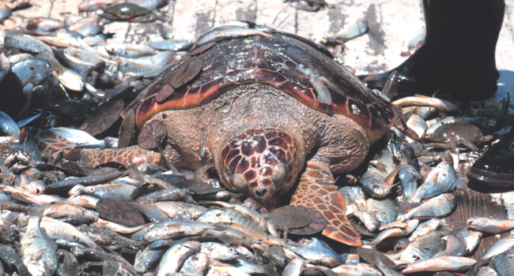
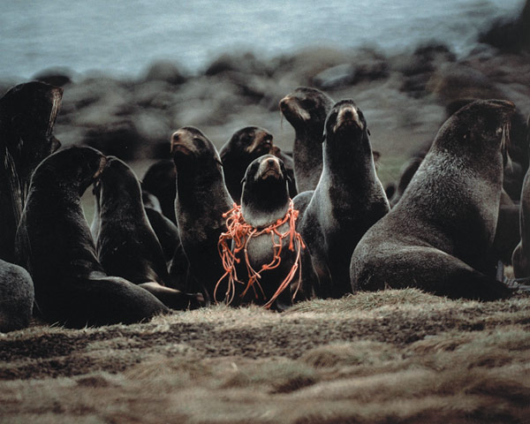
Human impacts on the Environment
Fishing activities
Demand for fish and shellfish
Commercial Fishing be harmful to environment in many ways

Slide 16
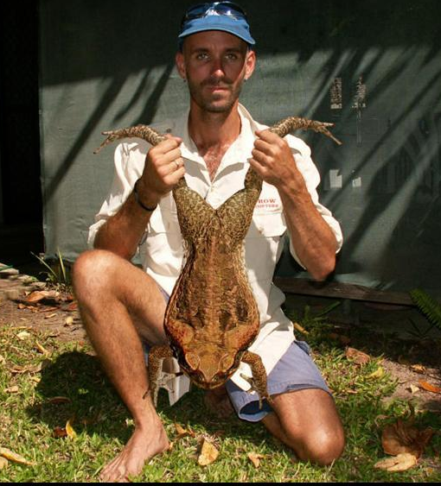
Human impacts on the environment
Invasive species (EXOTIC SPECIES)
introduced by people accidentally or intentionally
Can cause problems if no natural enemies are
present
Cane toad was introduced to Australia to control cane beetles, pest insects that destroy sugar cane crops

Slide 17
Human impacts on the Environment
Exotic pet trade
Capture and sell wild animals from
exotic locations
Wealthy buyers and collectors desire
obscure animals
Animals removed from their habitat
causes an imbalance in the ecosystem

Slide 18
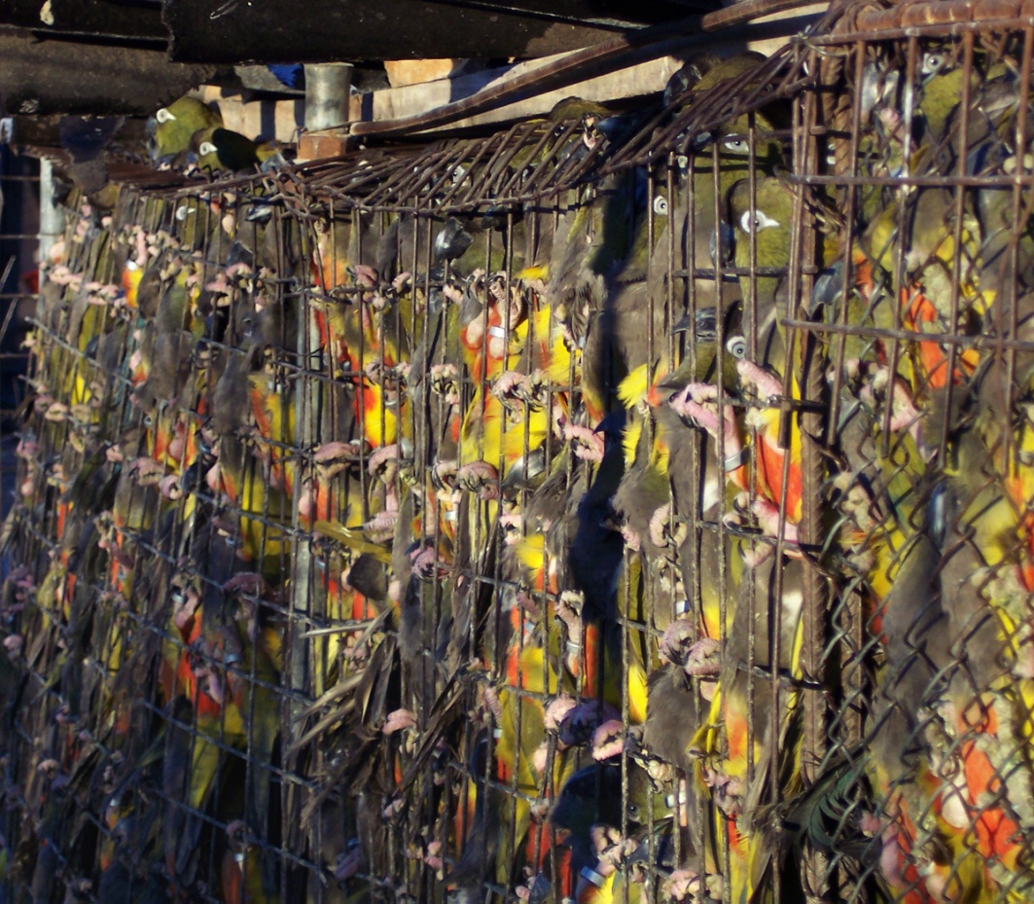

Slide 19
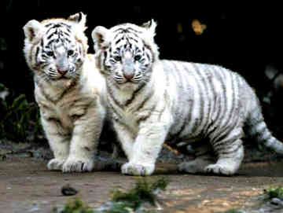

Slide 20
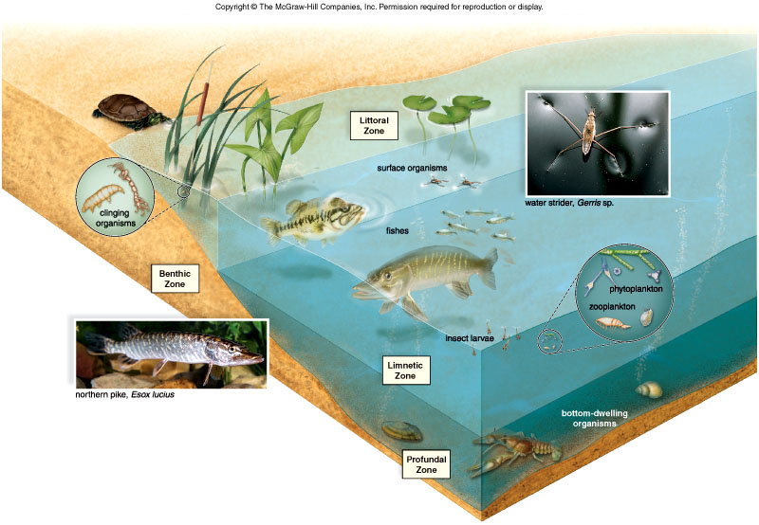
Importance of the Environment
Biodiversity = Many different types of organisms
Organisms depend upon one another
Interfering with one
Organism can have a
Ripple effect to many
w/in the habitat

Slide 21
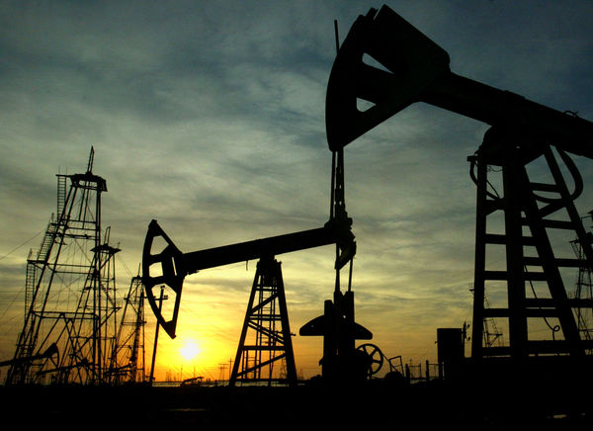
Importance of the environment
Natural resources:
Non-renewable includes fossil fuels (petroleum, coal)
Renewable includes animals, plants, water, wind, etc.
  even renewable resources can run out

Slide 22
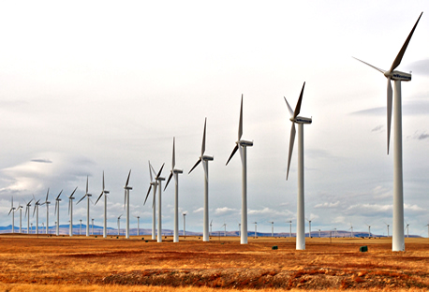
Importance of the Environment
Natural resources
Renewable energy sources include wind power, geothermal energy, ocean currents

Slide 23
Pollution:
Agricultural
  DDT
  Fertilizers
  Animal wastes (nitrogen)
Homes
  Strong cleaning agents
Industry
  Toxic gases and wastes
  Acid rain

Slide 24
Stewardship:

Slide 25
Group leaders:
Get your “RW.BKS”
Turn to ch. 5:
use as a resource to answer questions on Human Impact handout

